Slide 1

Business English for Arab Entrepreneurs
Radeeff Webinar, 2 August 2025

Slide 2


MEET YOUR TEACHER
Robert Dennis
I am a highly-experienced Business English teacher, published author, creative copywriter and translator.
I am originally from London.
robertdennis.it

Slide 3
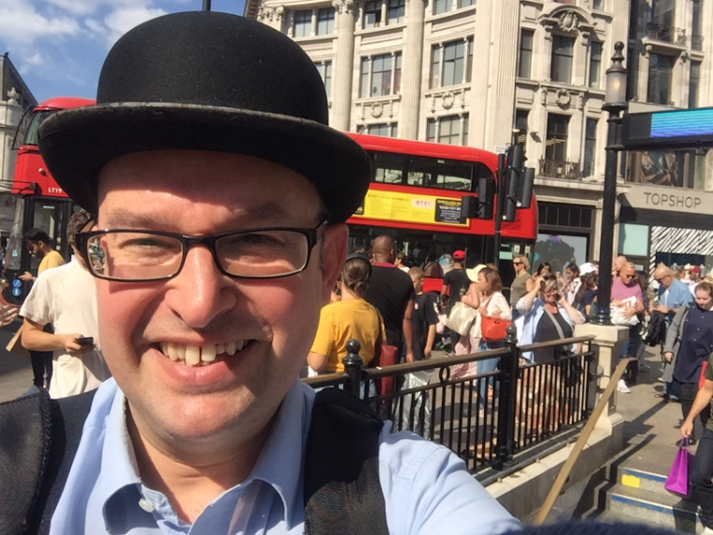
London!

Slide 4

ROBERT DENNIS
Experience
I have been teaching English for over 30 years both in the UK and Italy.
I specialise in teaching Business English and I have helped thousands of professionals to use
English successfully.
robertdennis.it

Slide 5
ROBERT DENNIS
Experience
I taught for many years in London.
My students included people from
the Gulf, Algeria, Morocco, Tunisia, Syria and other Arab countries.
robertdennis.it

Slide 6

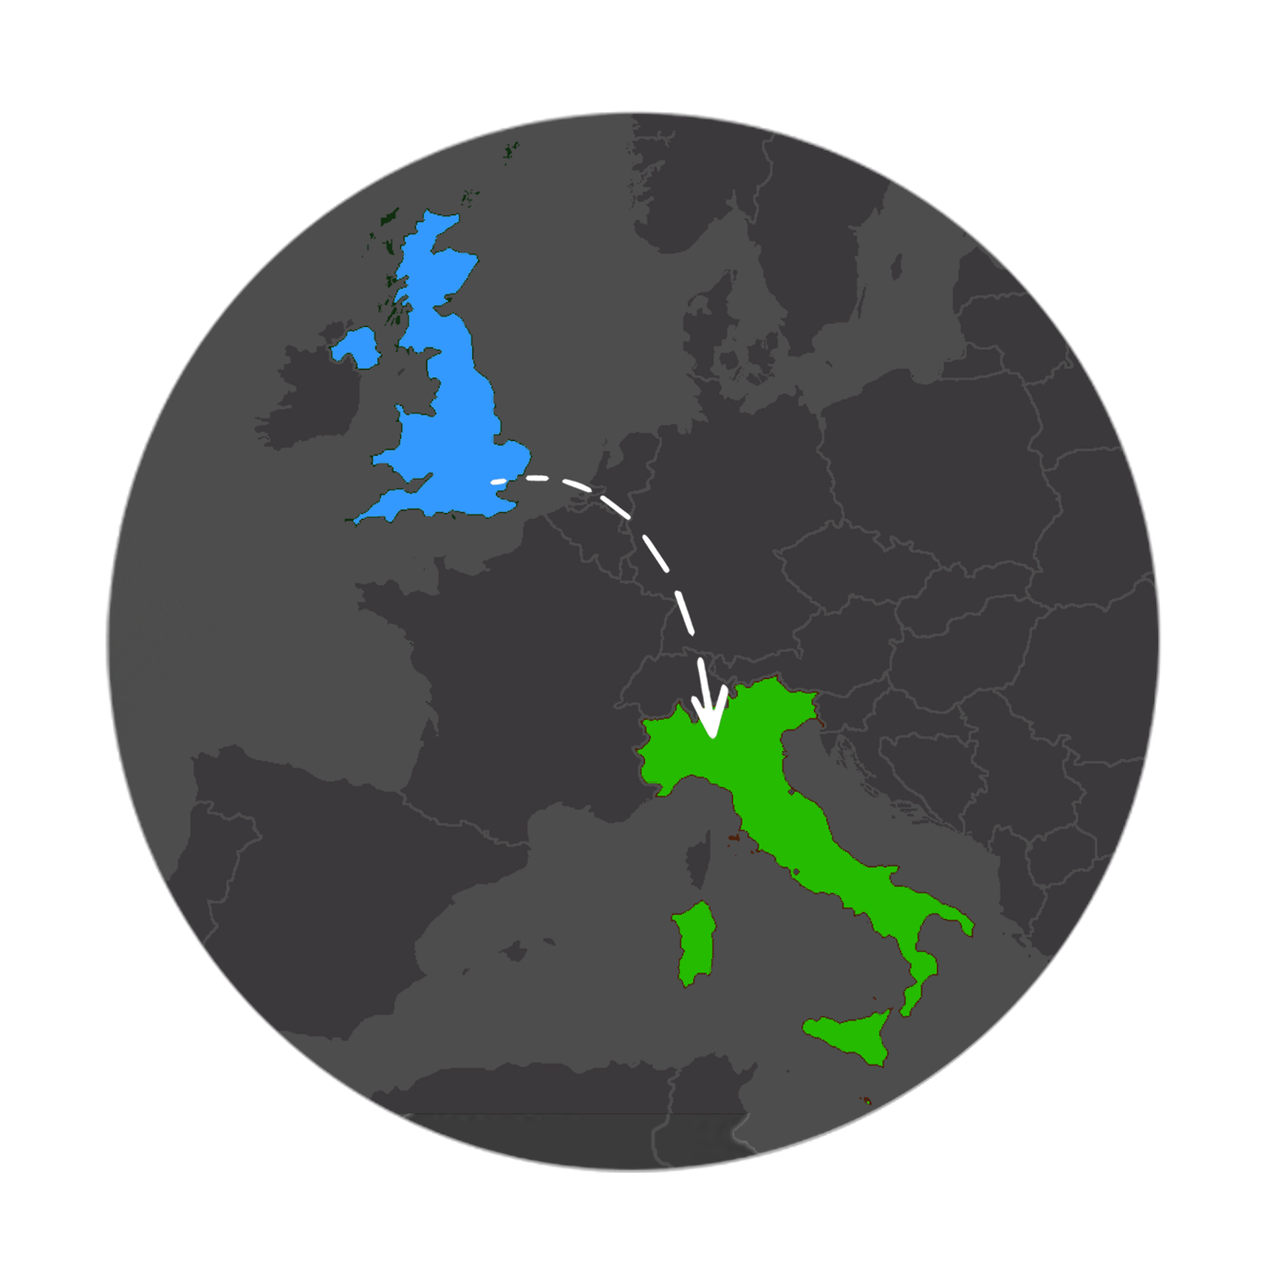
ROBERT DENNIS
Italy
I moved to Italy in 2008. I am based in Milan and I teach people working at banks, insurance and pharmaceutical companies, etc.

Slide 7

In 2020 I published a book called “Business English”.
It was promoted in Italy’s leading financial newspaper and was sold at newsstands throughout the country.

Slide 8


PAYASYOULEARN.COM
Pay As You Learn
My online courses
payasyoulearn.com
Includes “Learn Business English”
Speaking, vocabulary, grammar
Exercises, listening, video

Slide 9


Slide 10

Business English

Slide 11


BUSINESS ENGLISH
Telephoning
Being able to use the telephone
in English in business situations
is essential!

Slide 12
BUSINESS ENGLISH
Telephoning
Here are some valuable tips for
getting by on the phone in English.

Slide 13
BUSINESS ENGLISH
Telephoning
Here are some valuable tips for
getting by on the phone in English.
get by = manage / survive
(phrasal verb)

Slide 14
BUSINESS ENGLISH
Telephoning
Learn what to say
on the telephone!

Slide 15

BUSINESS ENGLISH
Telephoning
OK, let's start with some
very typical situations.

Slide 16
BUSINESS ENGLISH
Telephoning
When you phone a company, identify yourself like this:

Slide 17
BUSINESS ENGLISH
Telephoning
When you phone a company, identify yourself like this:
This is…

Slide 18
BUSINESS ENGLISH
Telephoning
For example:
Hello. This is
Muhammad Al-Fulani.

Slide 19
BUSINESS ENGLISH
Telephoning
Don’t say “I am” on the phone.

Slide 20
BUSINESS ENGLISH
Telephoning
Don’t say “I am” on the phone.

Slide 21
BUSINESS ENGLISH
Telephoning
Don’t say “I am” on the phone.
TYPICAL
MISTAKE!

Slide 22
BUSINESS ENGLISH
Telephoning
Say: This is…

Slide 23
BUSINESS ENGLISH
Telephoning
Say: This is…
E.g. This is Fatima Al-Fulani.

Slide 24
BUSINESS ENGLISH
Telephoning
Say: This is…
E.g. This is Fatima Al-Fulani.
E.g. = for example
(exempli gratia)

Slide 25

BUSINESS ENGLISH
Telephoning
If you want to speak to someone you can say:
Can I speak to…?

Slide 26
BUSINESS ENGLISH
Telephoning
If you want to speak to someone you can say:
Can I speak to…?
E.g. Can I speak to
Wendy Hill, please?

Slide 27
BUSINESS ENGLISH
Telephoning
You can also say:
May I speak to…?

Slide 28
BUSINESS ENGLISH
Telephoning
You can also say:
May I speak to…?
“May” is a bit more formal
than “can”.

Slide 29
BUSINESS ENGLISH
Telephoning
You can also say:
May I speak to…?
“May” is a bit more formal
than “can”.
May I speak to
Mr Bennett, please?

Slide 30
BUSINESS ENGLISH
Telephoning
Before putting a call through, check whether your colleague wants to talk to the
person calling.

Slide 31
BUSINESS ENGLISH
Telephoning
Before putting a call through, check whether your colleague wants to talk to the
person calling.
If he/she does,
you can say:
OK, I’ll put you through.

Slide 32
BUSINESS ENGLISH
Telephoning
Put someone through
is a phrasal verb meaning to transfer / connect.

Slide 33
BUSINESS ENGLISH
Telephoning
Put someone through
is a phrasal verb meaning to transfer / connect.
OK, I’ll put you through.

Slide 34
BUSINESS ENGLISH
Telephoning
It’s possible that your colleague is busy and cannot speak to
the person immediately.

Slide 35
BUSINESS ENGLISH
Telephoning
It’s possible that your colleague is busy and cannot speak to
the person immediately.
In this case, you can ask
the person if they can
wait/hold.

Slide 36
BUSINESS ENGLISH
Telephoning
It’s possible that your colleague is busy and cannot speak to
the person immediately.
In this case, you can ask
the person if they can
wait/hold.
Will you hold?

Slide 37
BUSINESS ENGLISH
Telephoning
It’s possible that your colleague is busy and cannot speak to
the person immediately.
In this case, you can ask
the person if they can
wait/hold.
Will you hold?
Can I put you on hold?

Slide 38
BUSINESS ENGLISH
Telephoning
And, of course, invite the person who called if he or she
wants to leave
a message:

Slide 39
BUSINESS ENGLISH
Telephoning
And, of course, invite the person who called if he or she
wants to leave
a message:
Would you like to
leave a message?

Slide 40
BUSINESS ENGLISH
Telephoning
If you have to leave a message on the phone, you can say:

Slide 41
BUSINESS ENGLISH
Telephoning
If you have to leave a message on the phone, you can say:
OK, can you tell him / her
that I have received
the documents they
sent me?

Slide 42
BUSINESS ENGLISH
Telephoning
If you have to leave a message on the phone, you can say:
OK, can you tell him / her
that I have received
the documents they
sent me?
Note: “they” here
means “he / she”.

Slide 43
BUSINESS ENGLISH
Telephoning
To finish your call, you can say:

Slide 44
BUSINESS ENGLISH
Telephoning
To finish your call, you can say:
It was great speaking to you.

Slide 45
BUSINESS ENGLISH
Telephoning
To finish your call, you can say:
It was great speaking to you.
Nice talking to you.

Slide 46
BUSINESS ENGLISH
Telephoning
To finish your call, you can say:
It was great speaking to you.
Nice talking to you.
Thanks for your call.

Slide 47
BUSINESS ENGLISH
Telephoning
To finish your call, you can say:
It was great speaking to you.
Nice talking to you.
Thanks for your call.
Talk to you again soon.

Slide 48
BUSINESS ENGLISH
Telephoning
To finish your call, you can say:
It was great speaking to you.
Nice talking to you.
Thanks for your call.
Talk to you again soon.
Take care.

Slide 49
BUSINESS ENGLISH
Telephoning
To finish your call, you can say:
It was great speaking to you.
Nice talking to you.
Thanks for your call.
Talk to you again soon.
Take care.
Bye!

Slide 50


Introducing yourself and your company
Example
HubSpot
Pitching

Slide 51
Introducing yourself and your company
My name is…
My company is called…
We are a communications startup based in Cairo.

Slide 52
Introducing yourself and your company
We specialise is providing Arabic language services to clients.
We are also experts in translation and localisation.

Slide 53
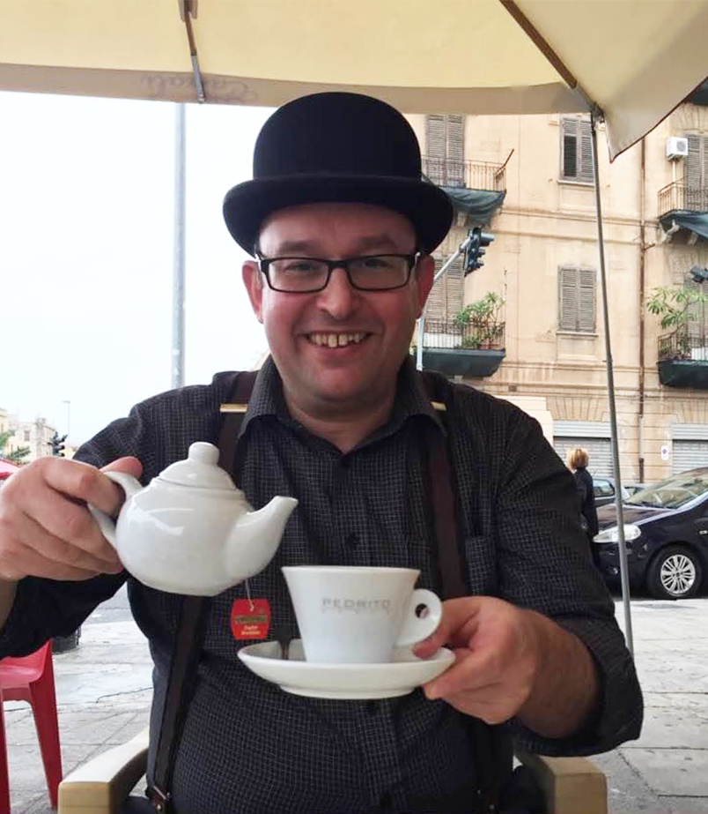
Thank you!
Robert Dennis
Business English Coach | Author | Language Consultant
www.robertdennis.it
Email: robert.dennis@gmail.com
Phone: (+39) 3470 573537

