Slide 1
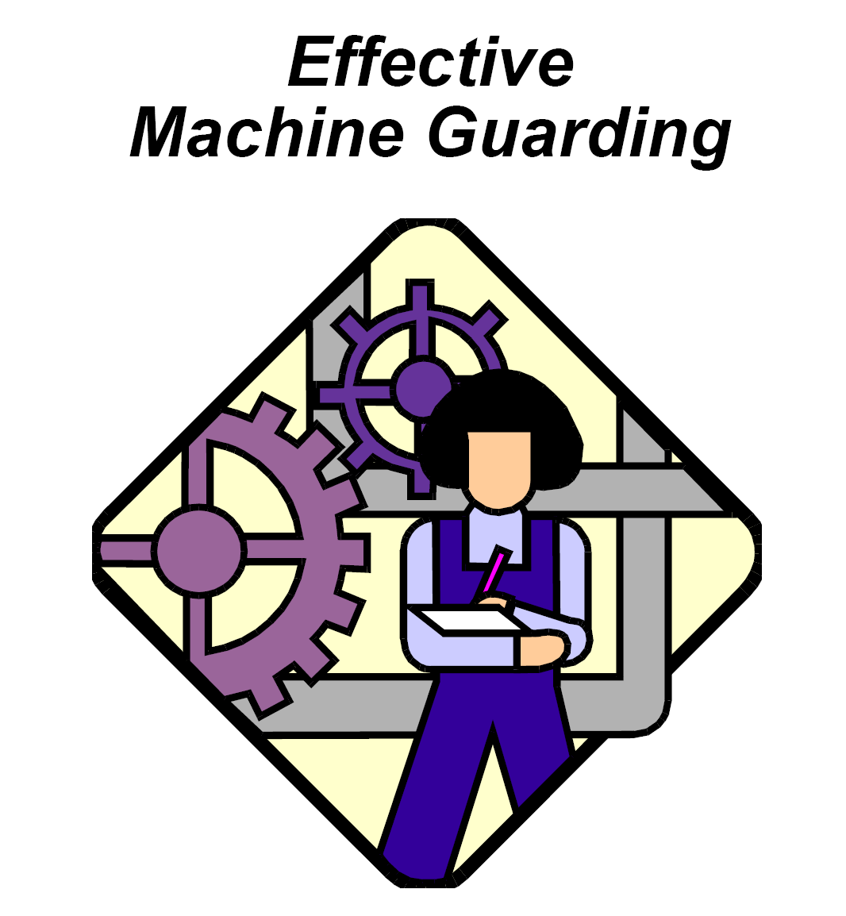

Slide 2
Goals
Describe the basic hazards involving machinery including point of operation and
power transmission devices.
Introduce control measures through effective machine guarding principles and methods.

Slide 3
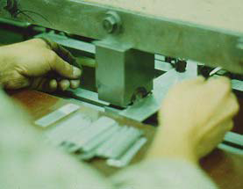

Where Mechanical Hazards Occur
1. The point of operation
  That point where work is performed.
    Cutting Shaping
    Boring Forming
2. Power transmission apparatus
All components of the mechanical system which transmit energy to the part of the machine
performing the work.
Flywheels Pulleys Belts
Couplings Cams Spindles
Chains Cranks Gears
Sprockets Shafts Rods

Slide 4
3. Other moving parts
All parts of the machine which move while the machine is working.
Reciprocating Rotating Transverse
Feed mechanisms Auxiliary parts

Slide 5
Hazardous Mechanical Motions & Actions
A wide variety of mechanical motions and actions may present hazards to the worker.
These can include the movement of rotating members, reciprocating arms, moving belts, meshing gears, cutting teeth, and any parts that impact or shear.
These different types of hazardous mechanical motions and actions are basic in varying combinations to nearly all machines, and recognizing them is the first step toward protecting workers from the danger they present.

Slide 6
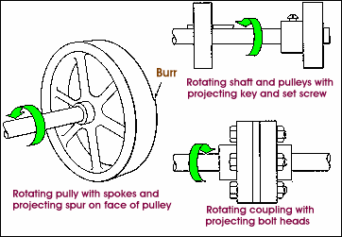
Motions
1. Rotating motion
• Collars • Couplings
• Cams • Spindles
• Meshing gears • Fans
• Clutches • Flywheels
• Shafts

Slide 7
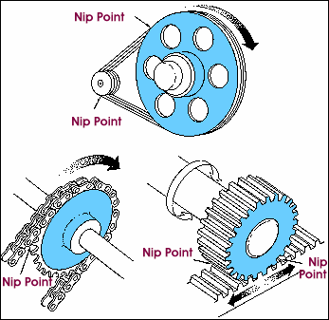
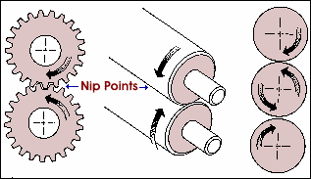
In-running nip point hazards
In-running nip point hazards
  There are three main types of in-running nips.
  Parts rotating in opposite direction
  Rotating and tangentially parts
  Rotating and fixed parts
Rotating and tangentially moving parts
Parts rotating in opposite direction

Slide 8
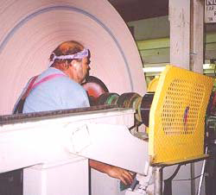
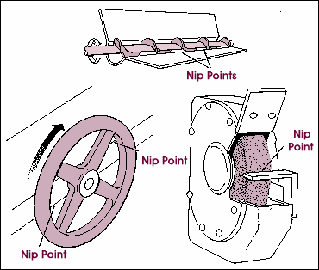

Slide 9
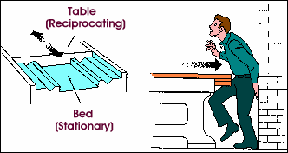
2. Reciprocating motion

Slide 10
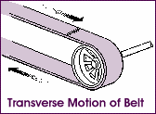
3. Transverse motion
Examples
• Conveyor lines
• Lengthy b

Slide 11
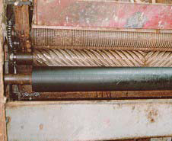
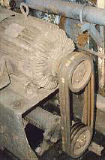
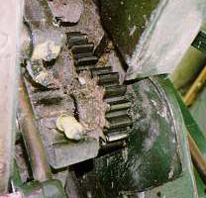
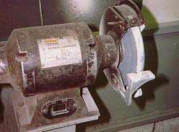
Identify each in-running nip point below

Slide 12
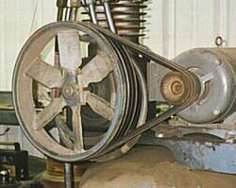

Slide 13
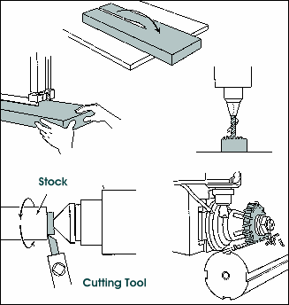
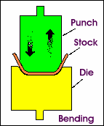
Hazardous Mechanical Motions & Actions
Cutting Shearing Bending Punching
Bending
Cutting

Slide 14
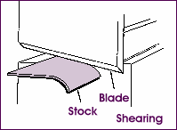
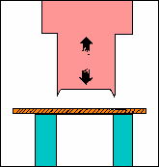
Shearing
Punching

Slide 15
Methods of Machine Guarding
Safeguarding strategies include:
  Guards
    Fixed
    Interlocked
    Adjustable
    Self-adjusting
  Devices
    Presence sensing
    Pullback
    Restraints
    Controls/Trips
    Gates

Slide 16
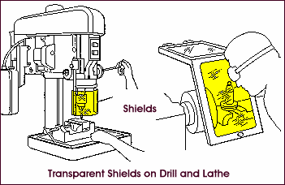
Other safeguarding strategies may include
Location/Distance
Feeding/Ejection Methods
  Automatic/semi-auto feed
  Automatic/semi-auto ejection
  Robotics
Miscellaneous aids can help reduce exposure
  Awareness barriers
  Protective shields
  Hand-feeding tools and holding fixtures

Slide 17
What makes a guard effective?
Must prevent any contact to the machine hazard and installed to prevent contact from around, over, through, or under the guard!
Must not present a hazard in itself
Must be affixed to the machine where possible
Conformity with other appropriate standards: ANSI, etc.

Slide 18
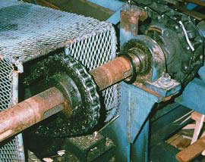
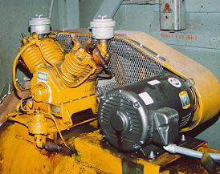

Slide 19
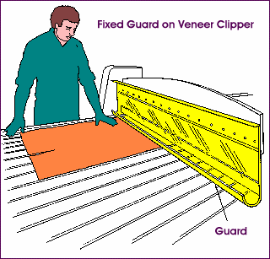
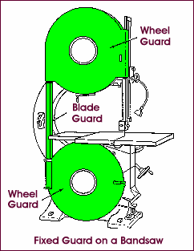
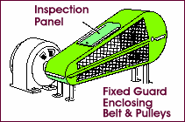
Fixed Guards

Slide 20
Interlocked Guards
When opened or removed, the tripping mechanism and/or power automatically shuts off or disengages
Machine cannot cycle or be started until the guard is back in place
Electrical, mechanical, hydraulic, or pneumatic power
Replacing the guard should not automatically restart the machine

Slide 21
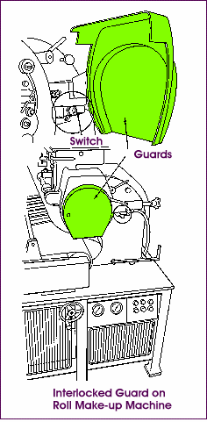
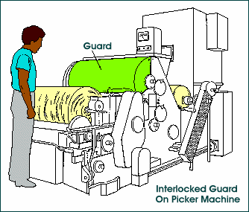
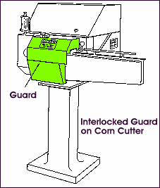

Slide 22
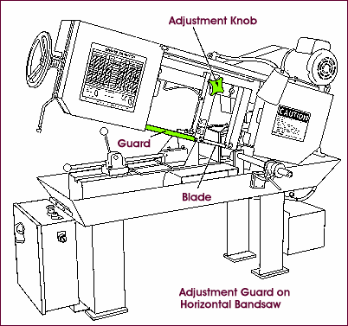
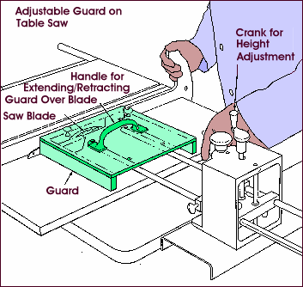
Adjustable Guards

Slide 23
Openings are determined by the movement of stock
  Guard is pushed away as stock is introduced;
  Opening is only large enough to admit the stock;
  Guard returns to rest position after stock passes through

Slide 24
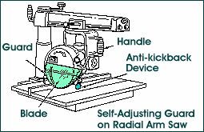
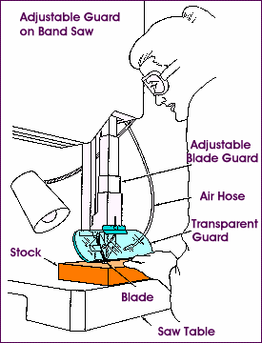

Slide 25
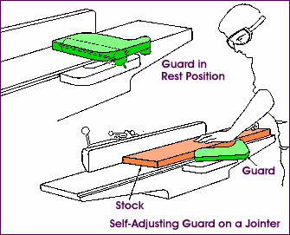
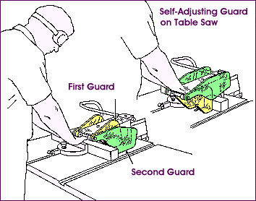

Slide 26
Second Safeguarding Strategy: Devices
A safety device may perform one of several functions.
It may stop the machine if a hand or any part of the body is inadvertently placed in the danger area;
Restrain or withdraw the operator's hands from the danger area during operation;
Require the operator to use both hands on machine controls; or
Provide a barrier which is synchronized with the operating cycle of the machine
in order to prevent entry to the danger area during the hazardous part of thecycle.

Slide 27
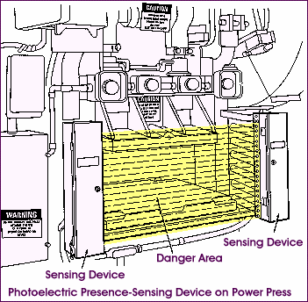
Presence-Sensing Devices
Photoelectric (optical)
Uses a system of light sources and controls which can interrupt the machine's operating cycle.

Slide 28
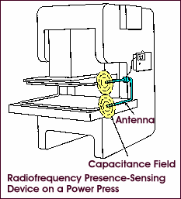
Radiofrequency (capacitance)
Radiofrequency (capacitance)
Uses a radio beam that is part of the machine control
circuit. When the capacitance field is broken, the machine
will stop or will not activate.

Slide 29
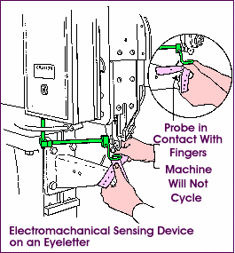
Electromechanical
Has a probe or contact bar which descends to a predetermined distance when the operator initiates the machine cycle. If there is an obstruction preventing it from descending its full predetermined distance, the control circuit does not a ctuatethe machine cycle.

Slide 30
Pullback
Pullback devices utilize a series of cables attached to the operator's hands, wrists, and/or arms. This type of device is primarily used on machines with stroking action.
When the slide/ram is up between cycles, the operator is allowed access to the point of operation.

Slide 31
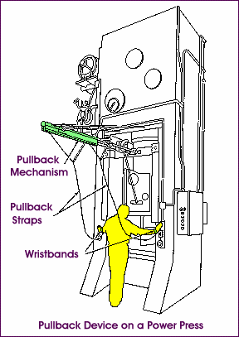
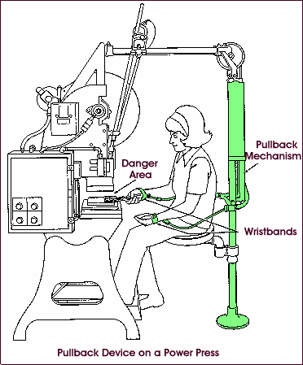

Slide 32
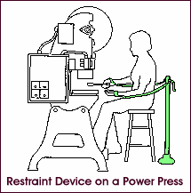
Restraint
The restraint (holdout) device utilizes cables or straps that are attached to the operator‘s hands at a fixed point. The cables or straps must be adjusted to let the operator's hands travel within a re determined safe area.
There is no extending or retracting action involved. Consequently, hand-feeding tools are often necessary if the operation involves placing material into the danger area.

Slide 33
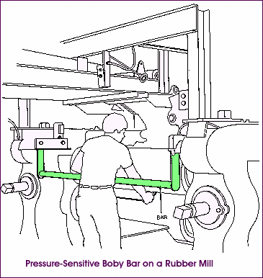
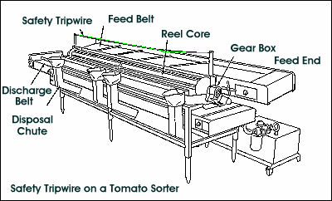
Safety Trip Controls
Provide a quick means for deactivating the machine in an emergency situation.
A pressure-sensitive bar, when depressed, will deactivate the machine.
Safety tripwire cables may also be
located around the perimeter or near
the danger area.

Slide 34
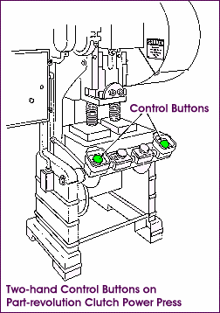
Two-Hand Controls
Requires constant, concurrent pressure by the operator to activate the machine. With this type of device, the operator’s hands are required to be at a safe location (on the control buttons) and at a safe distance from the danger area.

Slide 35
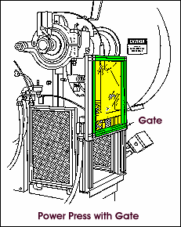
Two-Hand Trip
This device requires concurrent application of both the operator’s control buttons to activate the machine cycle ,after which the hands are free.
Gate
A gate is a movable barrier which
protects the operator at the point of
operation before the machine cycle
can be started. They are usually
designed to operate with each
machine cycle.
Two types: Type A & Type B

Slide 36
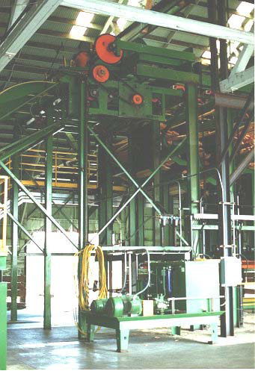
Third Safeguarding Strategy: Location & Distance
The machine or its dangerous moving parts are positioned so that the hazardous areas are not accessible or do not present a hazard during normal operation
What are some concerns
when considering guarding by location and/or distance?
__________________________
__________________________
__________________________
__________________________
__________________________

Slide 37
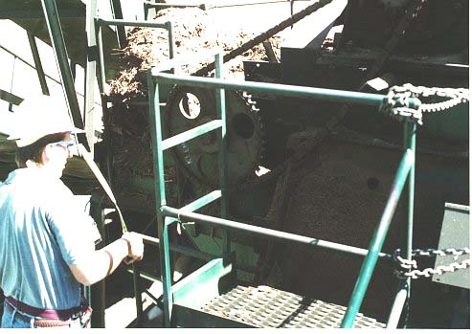

Slide 38
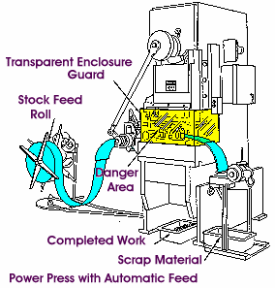
Fourth Safeguarding Strategy: Feeding & Injection
Automatic Feeding
  Operator involvement is not necessary after the machine is set up

Slide 39
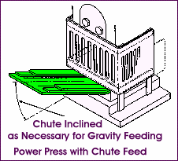
Fourth Safeguarding Strategy: Feeding & Injection
Semi-Automatic Feeding
  Manually feed without reaching into the point of operation or other danger zones

Slide 40

Automatic Ejection
  Require no operator involvement

Slide 41
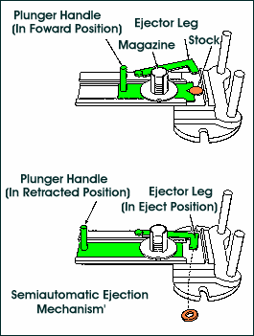
Semiautomatic Ejection

Slide 42
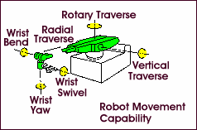
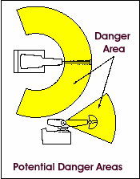
Robots
  Machines that load and unload stock, assemble parts, transfer objects, and perform other tasks - otherwise done by the operator.

Slide 43

What are some
concerns when
considering robotics?
___________________
___________________
___________________
___________________

Slide 44
Fifth safeguard strategy: Miscellaneous Aids
May not give complete protection from machine hazards, but may provide theoperator with an extra margin of safety.
Examples:
  Awareness barriers
  Ropes
  Shields
  Holding tools
  Push sticks or blocks

Slide 45




Slide 46

Let's review!

Slide 47

Machine Guarding Checklist

Slide 48


Slide 49

Requirements for all Safeguards (continued)

