Slide 1
CULTURE MEDIA

Slide 2
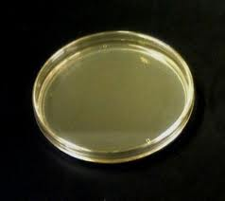
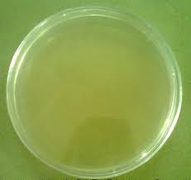
NUTRIENT AGAR

Slide 3
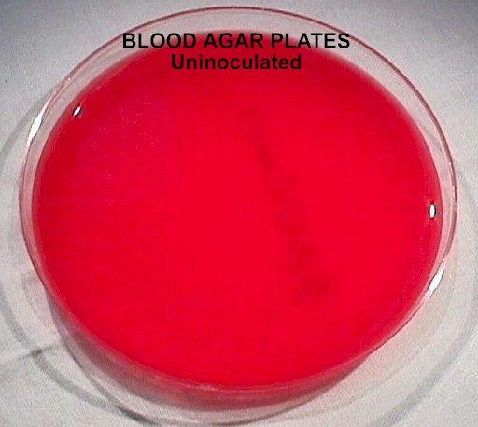
BLOOD AGAR

Slide 4
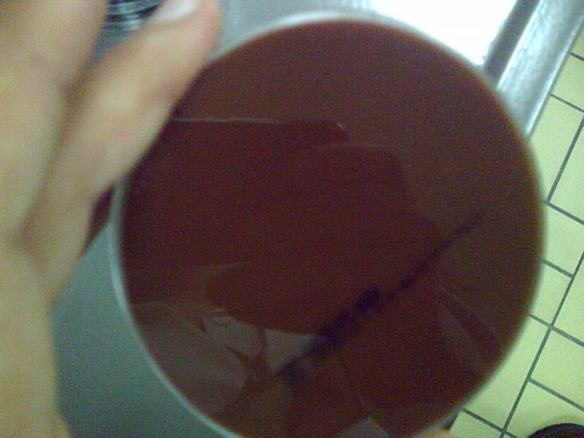
CHOCHLATE AGAR

Slide 5
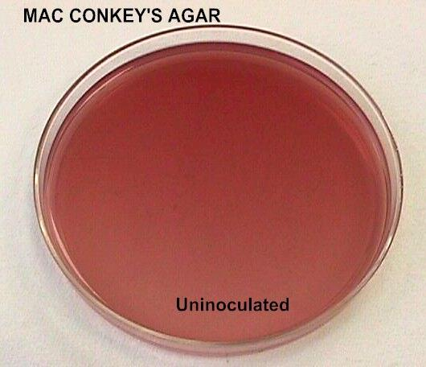
MAcCONKEY AGAR

Slide 6
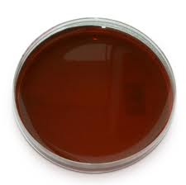
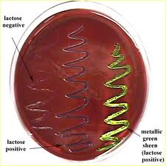
EOSIN METHYLENE BLUE

Slide 7

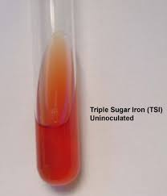
Kliglar Iron Agar Triple Sugar Iron Agar

